Slide 1
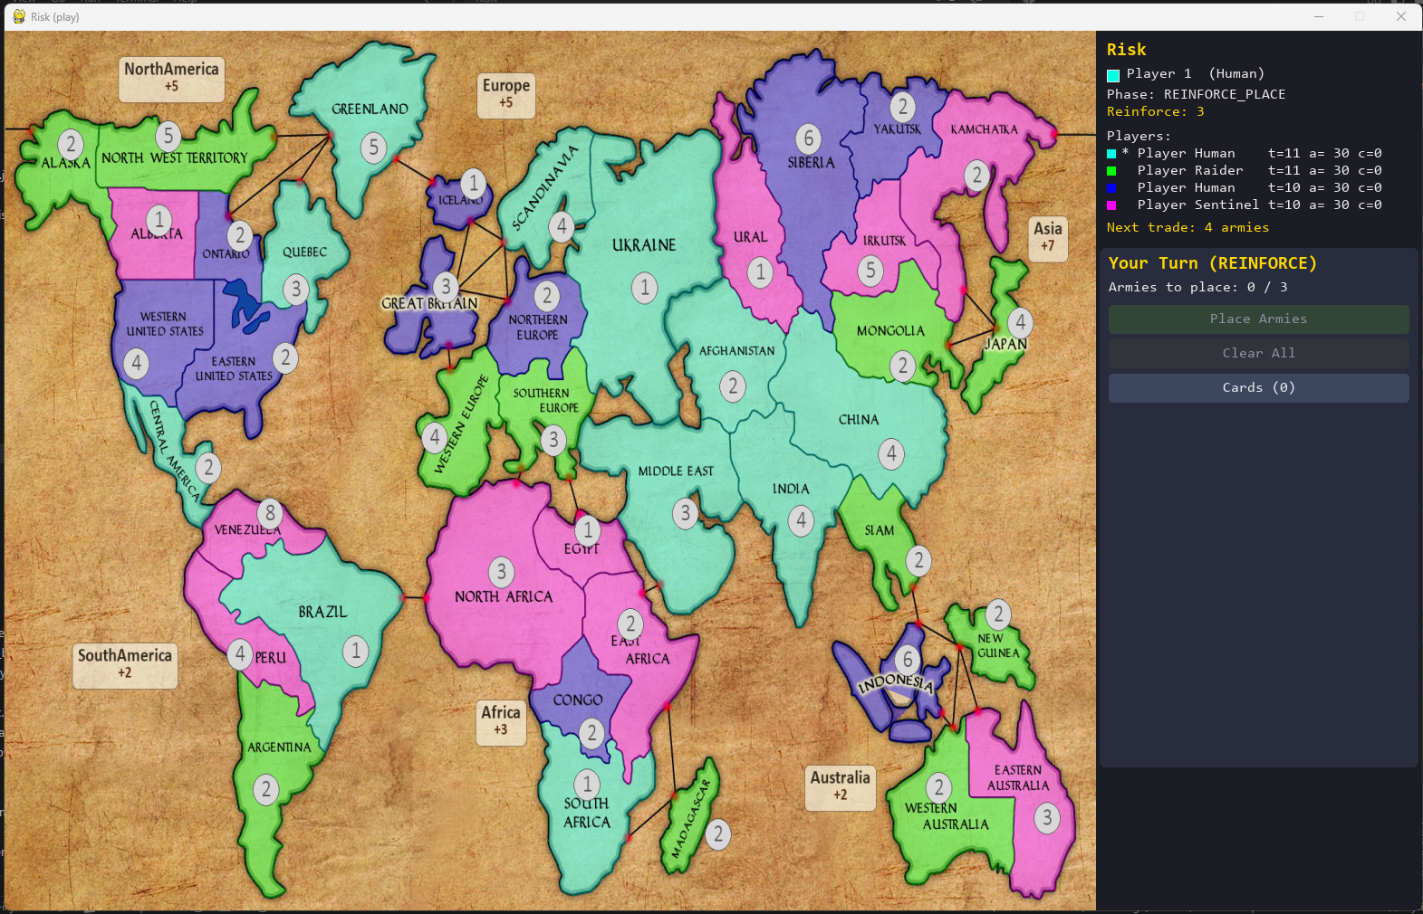

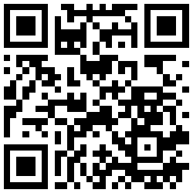

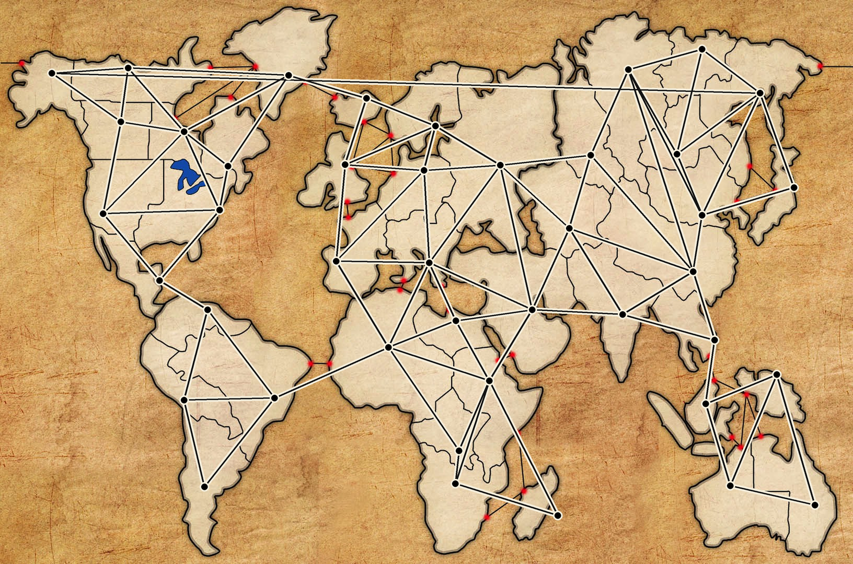
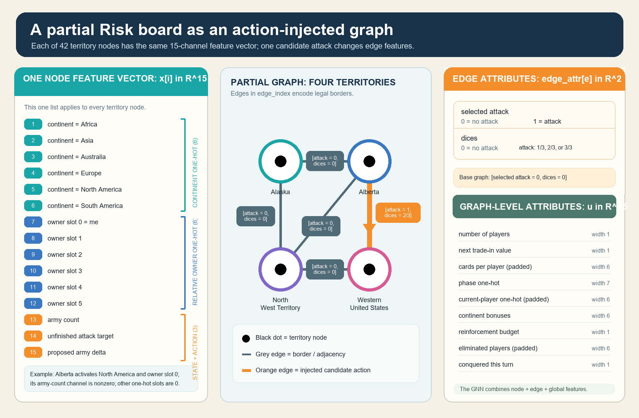
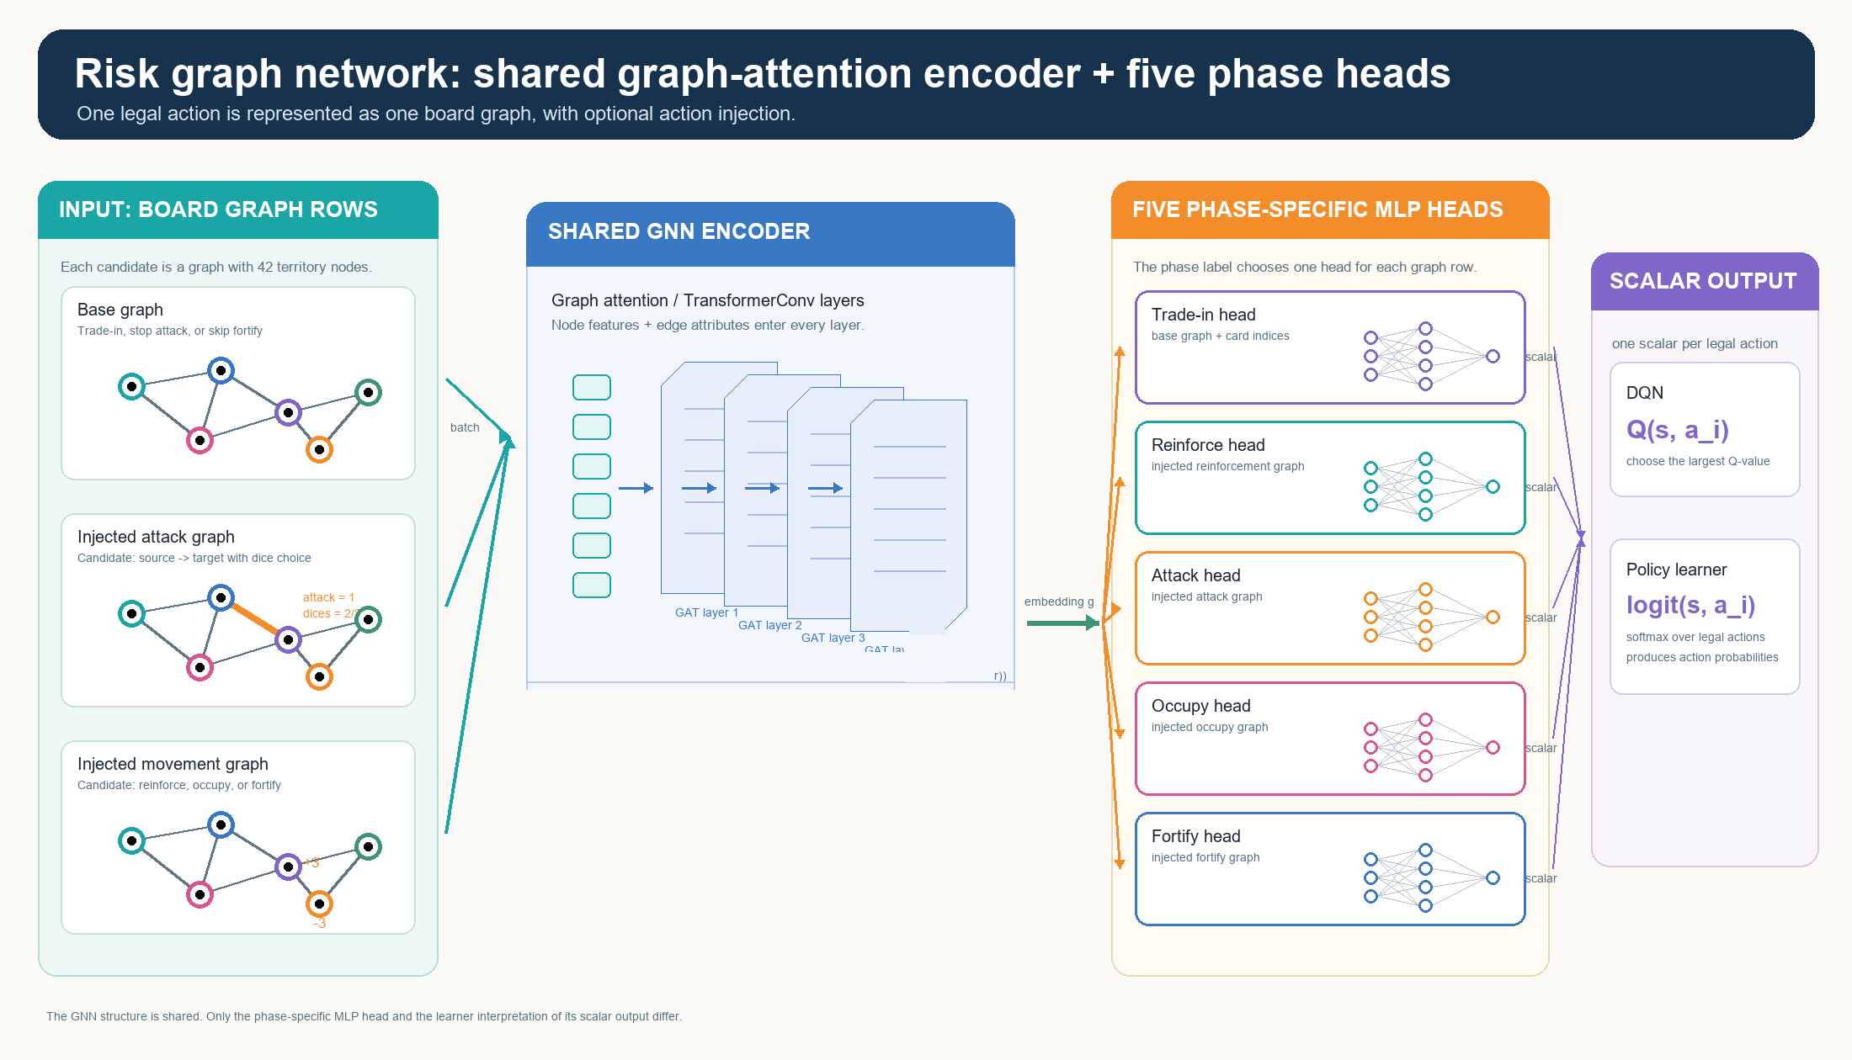
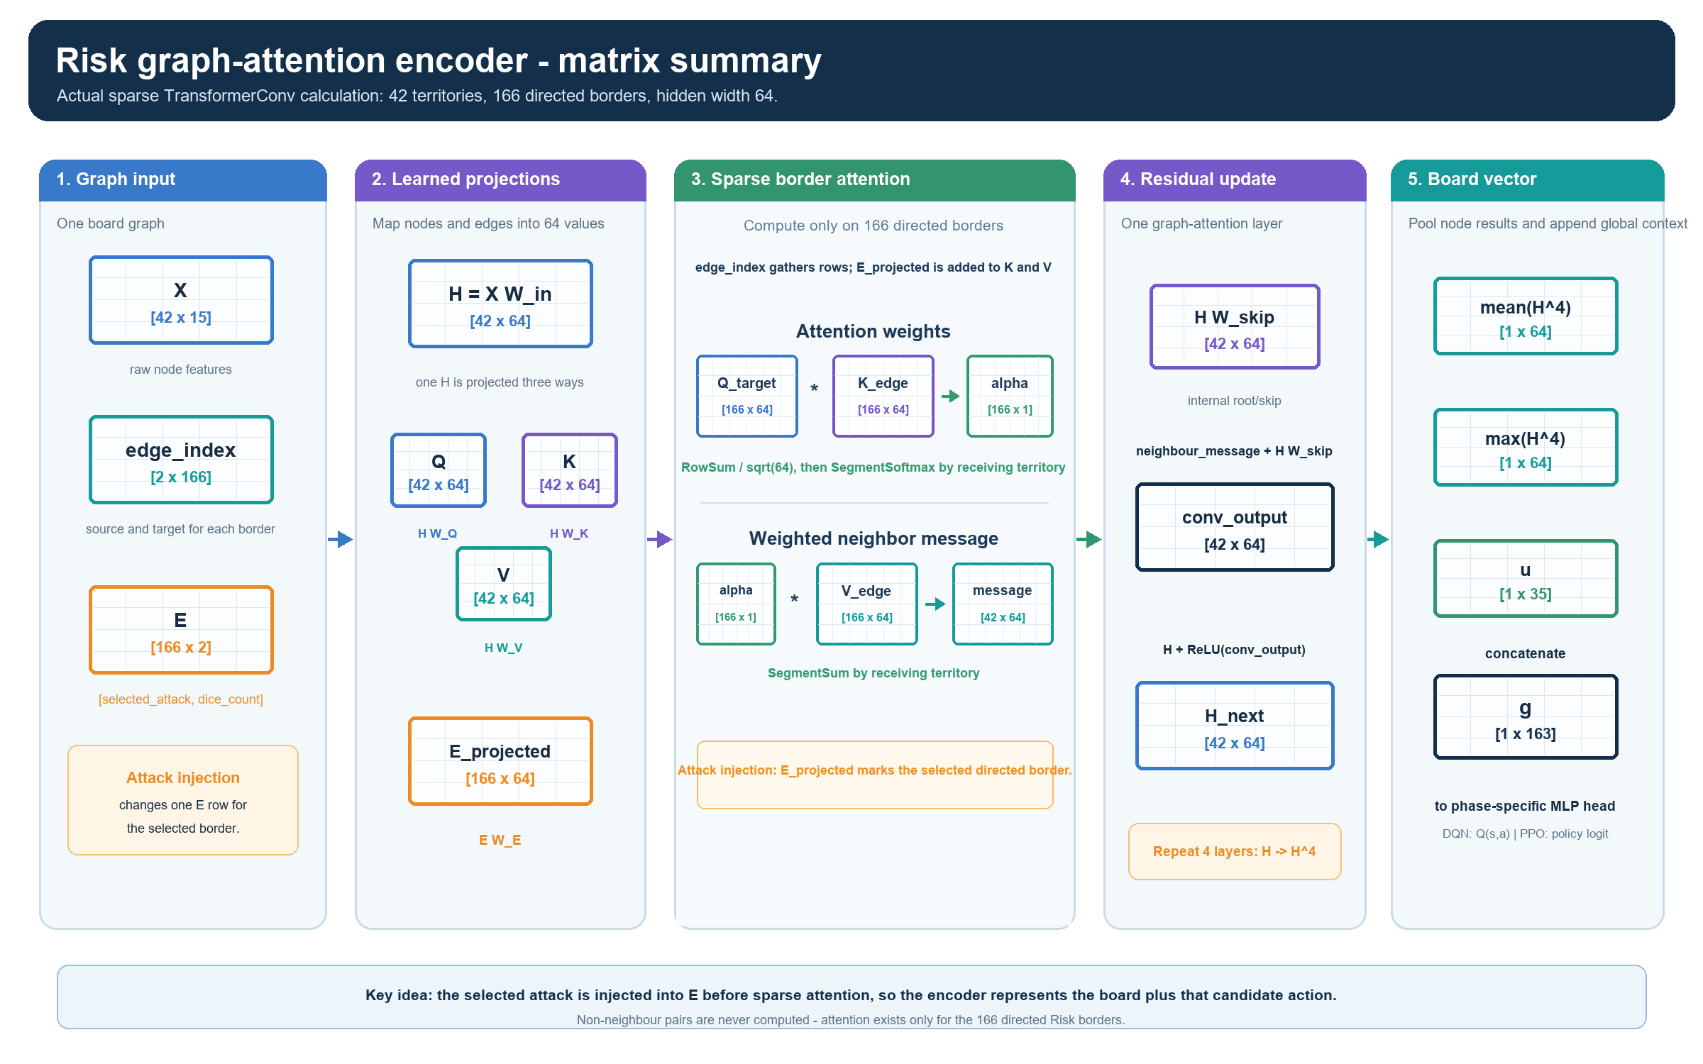
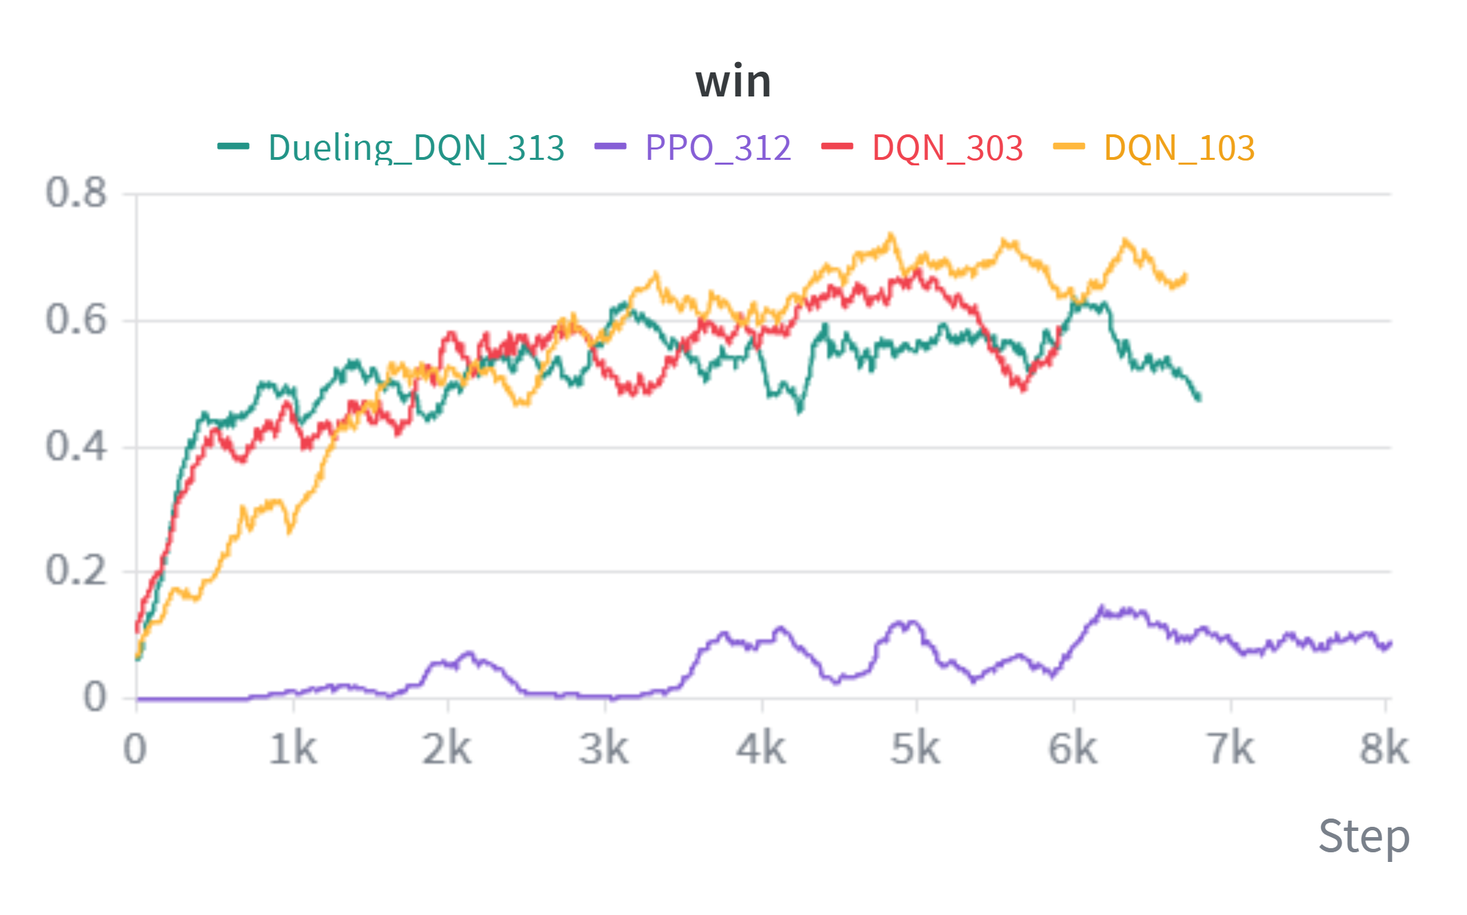
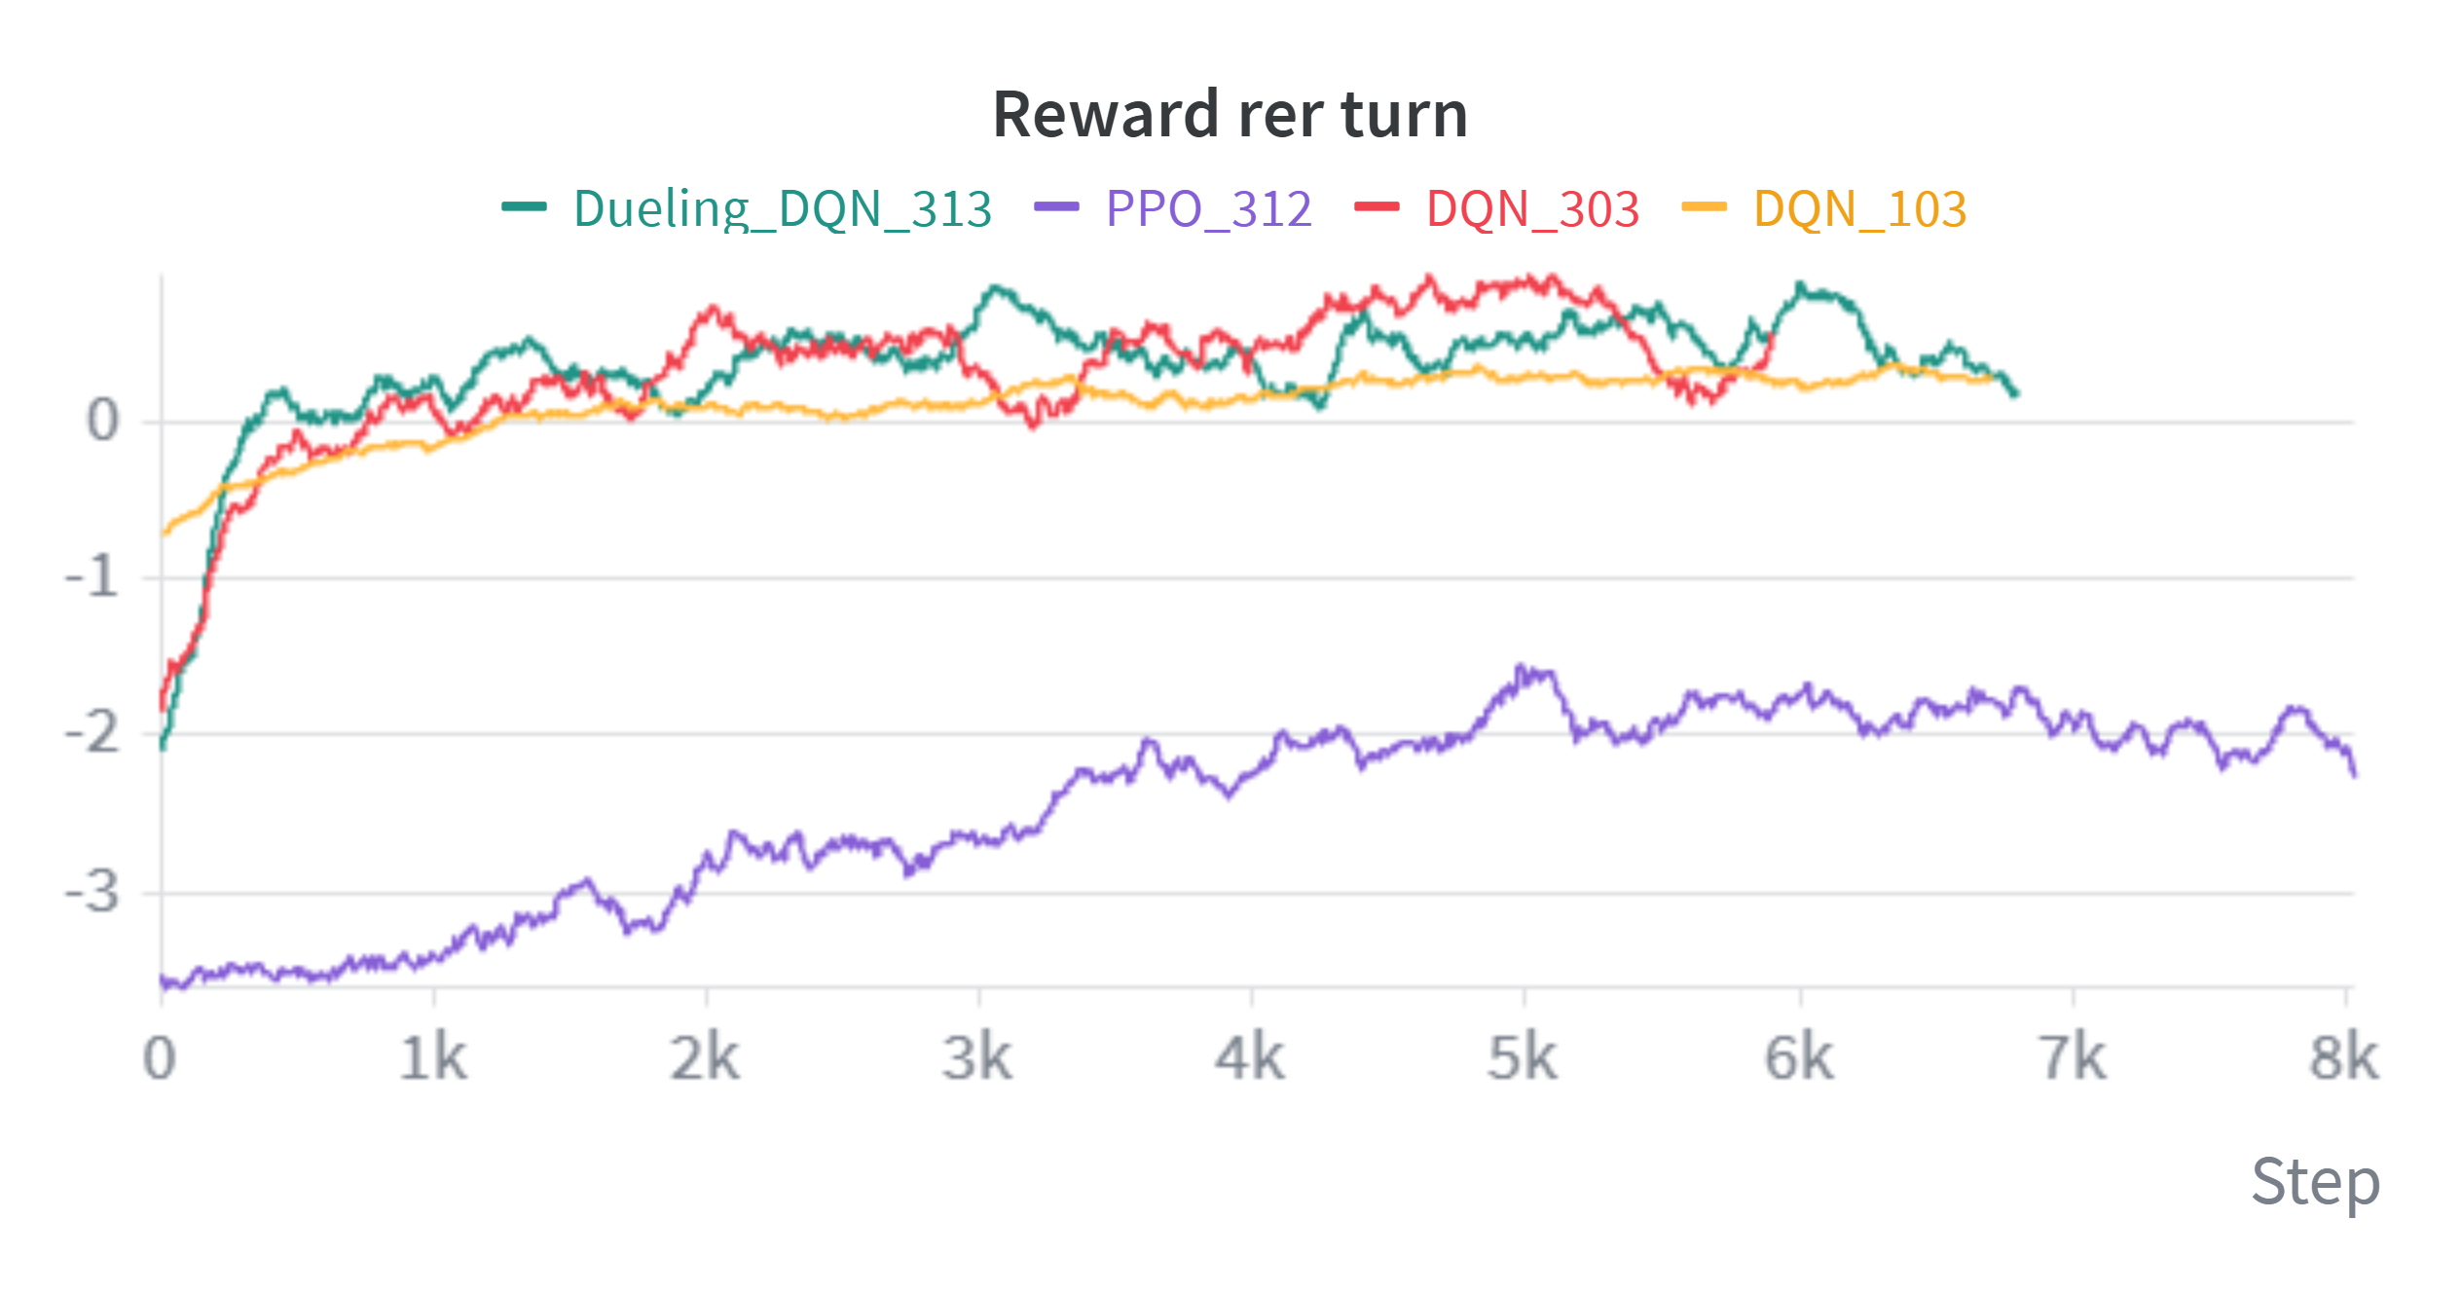
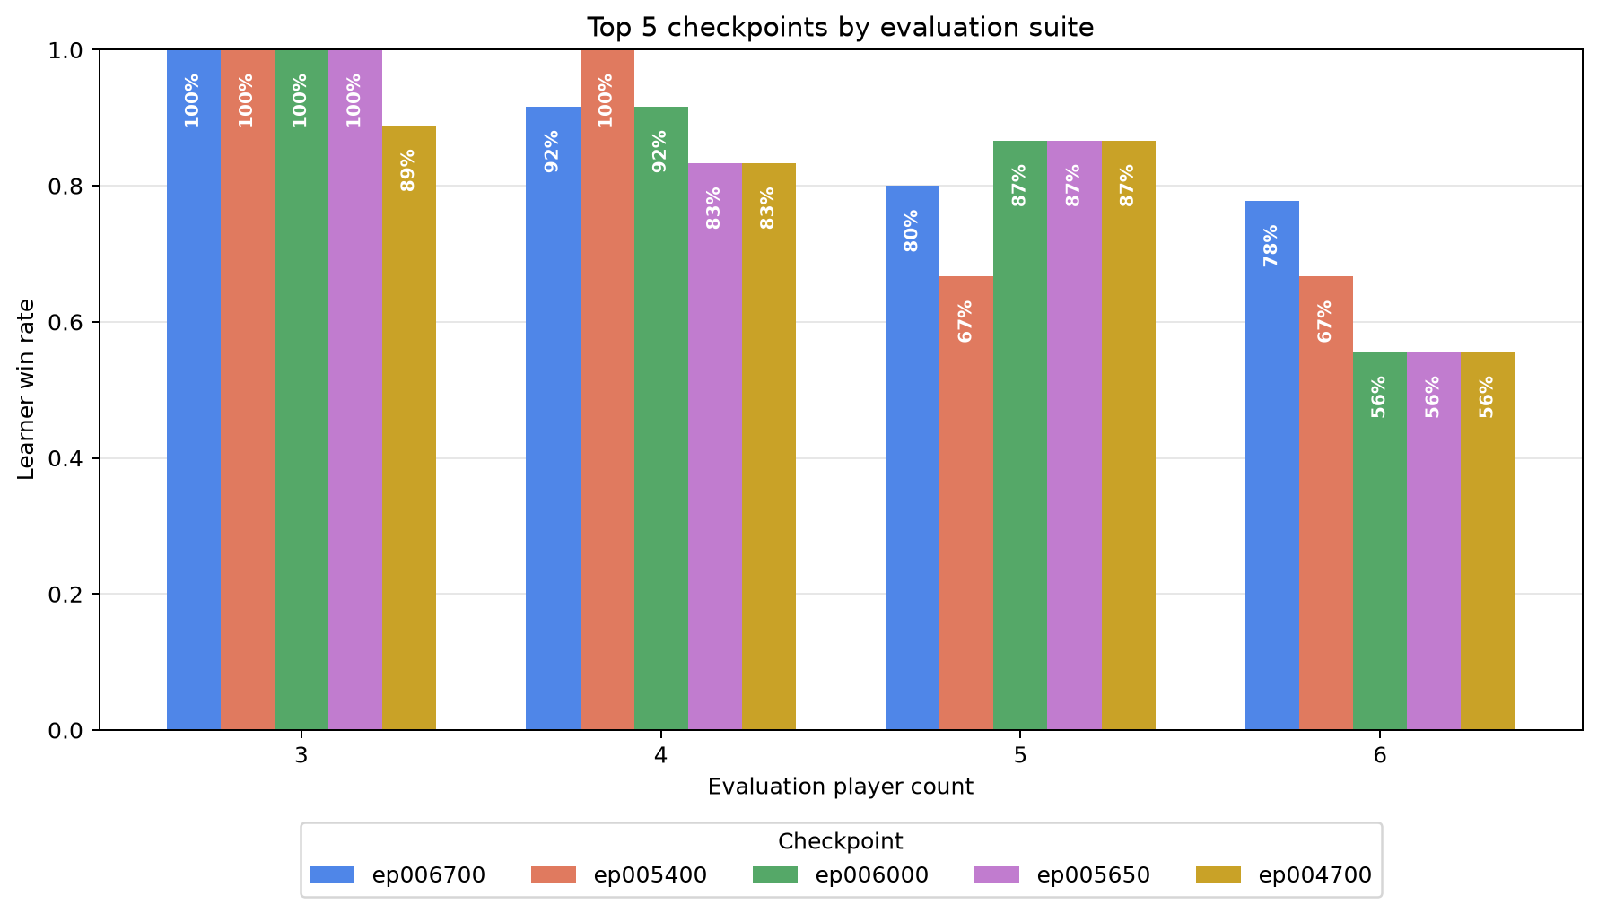
Learning to Play Risk with
Action-Injected Graph Neural Networks
A graph-attention reinforcement-learning approach, compared across DQN, Dueling DQN, and PPO
PROJECT REPOSITORY
Gilad Markman • 2026
Practical Deep Learning for Science • Prof. Eilam Gross
Instead of scoring one enormous fixed move list, the system injects each legal Risk move into the board graph and scores that state–action graph with one shared graph-attention encoder.
1 Board as a graph
2 Inject each legal candidate action
3 Shared GATN encoder + phase heads
Risk's territories and borders are relational: move quality depends on neighbours, armies, and contested continents.
The action becomes part of the graph: an attack changes one border; other phases mark affected territory rows.
Four TransformerConv layers read the injected graph; the current Risk phase selects its small scoring head.
42 territory nodes | 83 borders | 166 directed edges
X [42 x 15] E [166 x 2] u [1 x 35]
How GATN attention uses the injected action
Reward shaping
Phase / trigger | Key DQN_103 calculation | What it teaches
Terminal (game ends) | +100 win; -100 loss (unscaled) | Winning stays the main objective.
Trade-in (optional at 3-4 cards) | +/- 0.30 x hand factor / card-set value +0.60 if a traded card matches an owned territory | Save an optional trade unless it creates value.
Reinforce (place armies) | +1.2 x share placed on a territory bordering an enemy +1.5 x [min(own / weakest adjacent enemy, 2.5) - 1] -0.8 on a safe interior territory | Build an attack-capable border; do not park armies where they cannot fight.
Attack (choose / resolve) | 2 x [min(attacker / defender, 3) - 1.5] +0.6 x (defender losses - attacker losses) +1.2 conquest; +4 continent; +4 + 1.5/card elimination | Use strong odds, maximum dice, and profitable battles.
Occupy + fortify (move armies) | + moved / movable into a captured territory or toward an enemy border Penalty for moving away or leaving two borders badly balanced | Put force where an opponent can attack, then keep it there.
Board progress (after opponents) | 20 x territory-share change; 0.1 x army-share change 2.5 x continent-bonus change; extra continent-loss penalty | Reward gains that survive a full opponent round.
GATN attends only across neighboring territories. Q represents the receiving territory; K determines how relevant each neighbor is; V is the information that neighbor sends. The injected action changes K and V on the affected border, changing its attention weight and message.
Reward =
terminal (+100 / -100)
+
0.1 x local action terms +
0.1 x board progress after opponents.
Four graph-attention layers aggregate these weighted neighbor messages—never all territory pairs.
Local shaping applies only to learner decisions; board progress is separately scaled (not clipped) after every opponent has played.
E [166 x 2] -> E_projected -> K_edge / V_edge -> segment softmax
Results: training + held-out evaluation
DQN learning; learner comparison; DQN evaluated across 3–6 players.
DQN
Learner comparison
DQN evaluation
Current DQN data
DQN | Dueling DQN | PPO
Top 5 checkpoints · 54 games each
54 games / checkpoint
3 seeds · every learner seat
ε = 0 · 2,000-step cap
54 games / checkpoint
3 seeds · every learner seat
ε = 0 · 2,000-step cap
54 games / checkpoint
3 seeds · every learner seat
ε = 0 · 2,000-step cap
Latest ep006700
46 / 54 wins = 85.2% · 0 timeouts
Latest ep006700
46 / 54 wins = 85.2% · 0 timeouts
Latest ep006700
46 / 54 wins = 85.2% · 0 timeouts
Notes:
[Sources]
Poster narrative and local visual assets adapted from Docs/Poster.md.
Results:
- DQN card and temporary learner-comparison graphic: Assets/DQN Win.png.
- DQN_103 cross-player-count evaluation: Checkpoints/DQN_103/evaluations/top5_checkpoint_win_rates_all_player_counts.png; checkpoint_eval_ep006200_to_006700.json. Evaluation protocol: 54 games per checkpoint (3 seeds x learner seat x 3-6 total players), epsilon 0, 2,000-step cap.
Reward shaping behind DQN_103:
- Historical checkpoint configuration: wandb/run-20260801_170850-sad3393d/logs/debug.log (REWARD_SHAPING_SCALE=0.1; terminal +/-100).
- Historical implementation: commit 1411c0d (reward.py and train_constants.py). Dense learner-action terms were summed, clipped to [-10,+10], then multiplied by 0.1; terminal reward was unscaled. End-of-turn board progress was separately scaled by 0.1 and measured after opponents acted.
- The poster table summarizes terminal, trade, reinforce, attack, occupy/fortify, and board-progress terms in plain language. Docs/Reward.md contains the full current reward reference; it does not retroactively describe DQN_103's historical values.
Methods and architecture:
- Docs/NetworkArchitectures.md, Docs/DuelingDQN.md, Docs/PPO.md, Docs/Reward.md.
Branding and QR assets are local project assets; Weizmann logo was user-provided.

